Slide 1
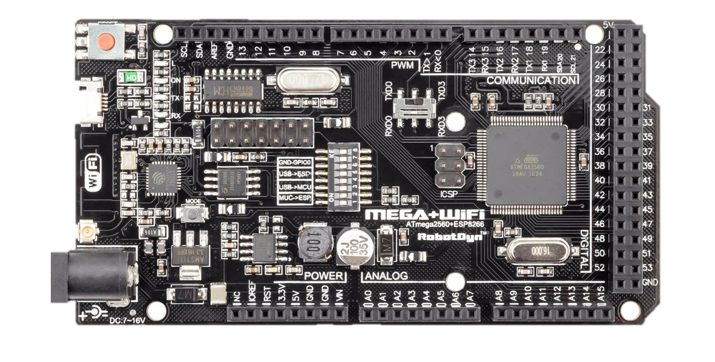
ATmega2560+ESP8266
การใช้งานเบื้องต้น
BY-WASAN

Slide 2
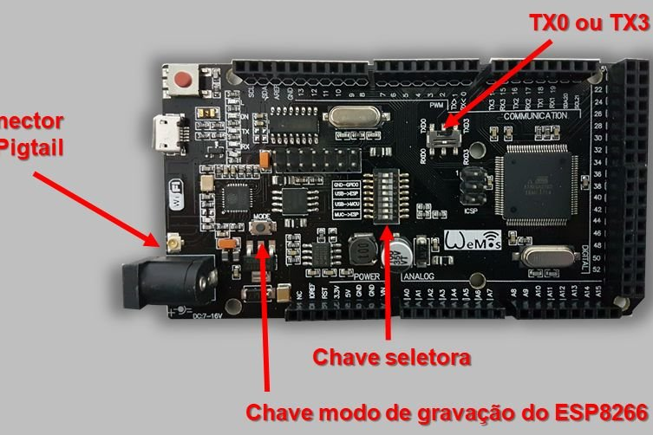

Slide 3
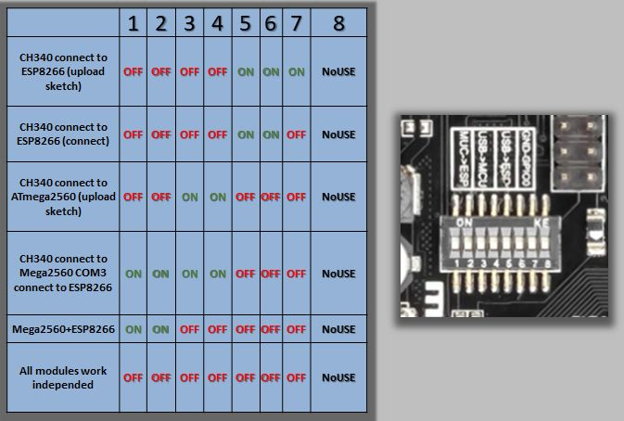

Slide 7
Downloads
Driver CH340
https://robotdyn.com/pub/downloads/comp_docs/CH340/CH341SER.ZIP
Example Code
https://drive.google.com/open?id=1TeGbQl0z23dEdB7Ulfh6pZUNMJ2DrLff

Slide 8
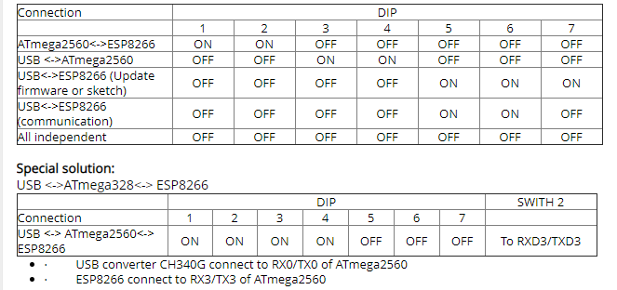
ตาราง Dip Switch

Slide 9
REF.
http://www.sysengineering.ru/blog/%D1%8D%D0%BB%D0%B5%D0%BA%D1%82%D1%80%D0%BE%D0%BD%D0%B8%D0%BA%D0%B0-%D0%BA%D0%BE%D0%BD%D1%82%D1%80%D0%BE%D0%BB%D0%BB%D0%B5%D1%80-arduino-mega-%D1%81-esp8266/

